Slide 1
Power Supply Design
Andrew Hellrigel

Slide 2
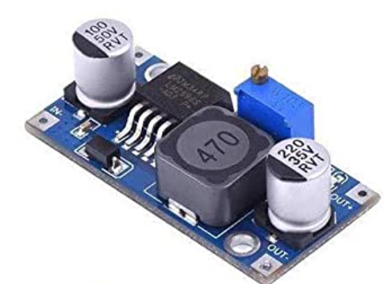
Current Solution
LM2596S Adjustable Buck Converter
Input 3-40V Output 1.5-35V (3A)
Problems
Not super efficient for our use case
It’s big
It’s annoying to use (plus I’m always worried about the pot accidentally spinning and not maintaining voltage)

Slide 3
Goals
More efficient (At 3.3V and 5V)
Smaller
Similar in price (Cost about $1.40-1.70/unit for 6 on Amazon)
Similar capabilities

Slide 4
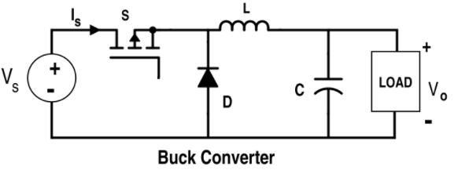
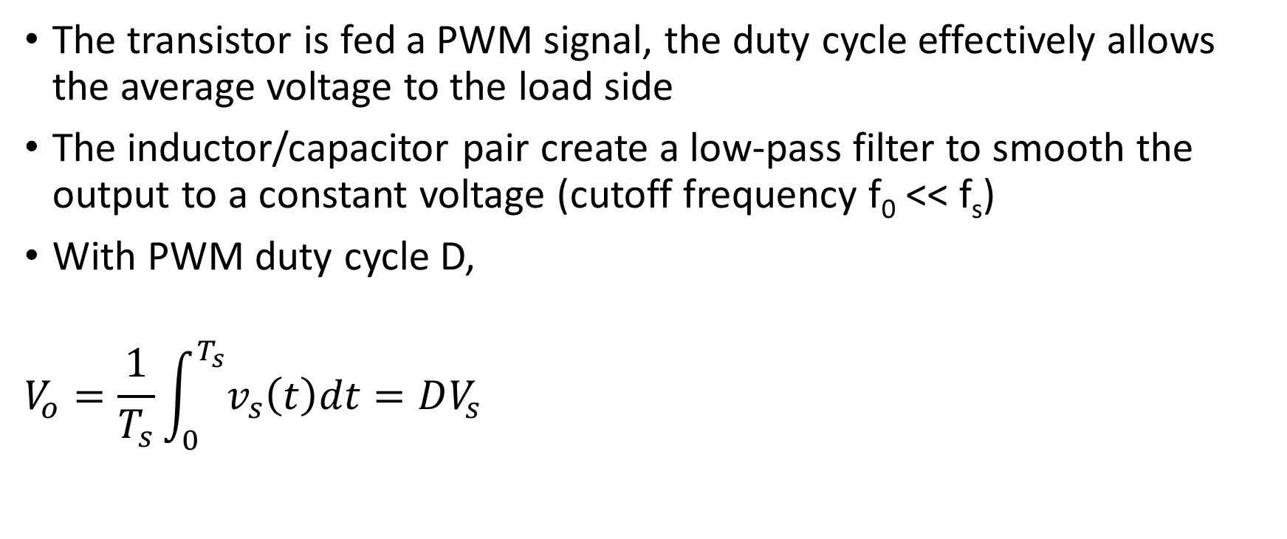
How do Buck Converters Work?
The transistor is fed a PWM signal, the duty cycle effectively allows the average voltage to the load side
The inductor/capacitor pair create a low-pass filter to smooth the output to a constant voltage (cutoff frequency f₀ << f_{s})
With PWM duty cycle D,
$$V_{o}=\frac{1}{T_{s}}\int_{0}^{T_{s}}{v_{s}\left(t\right)dt=DV_{s}}$$

Slide 5
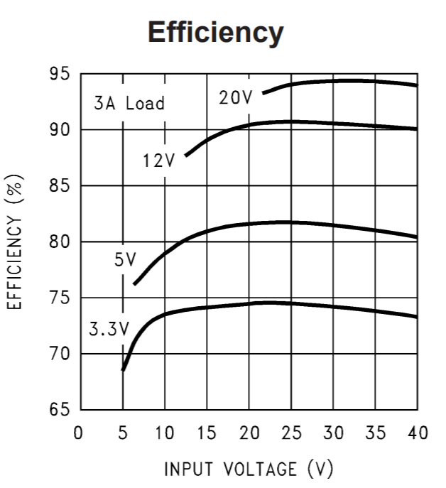
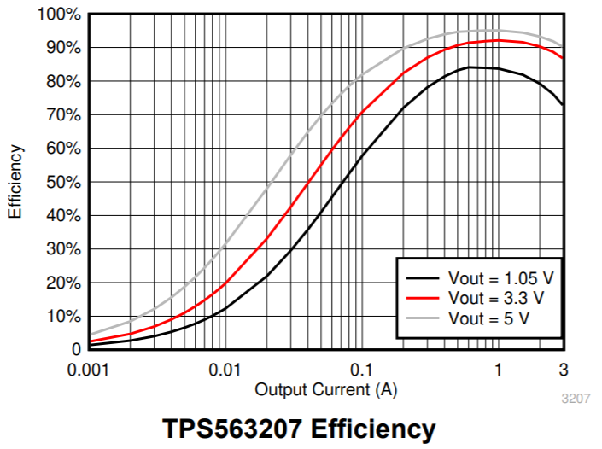
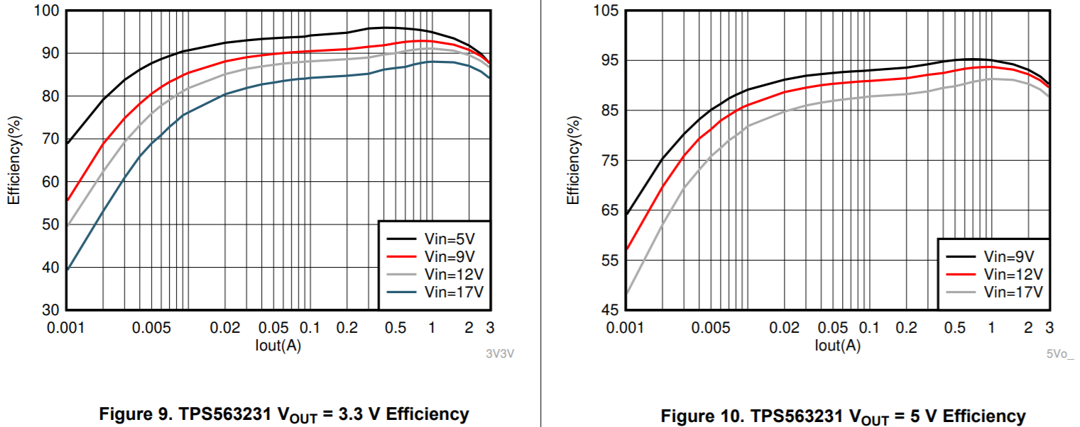
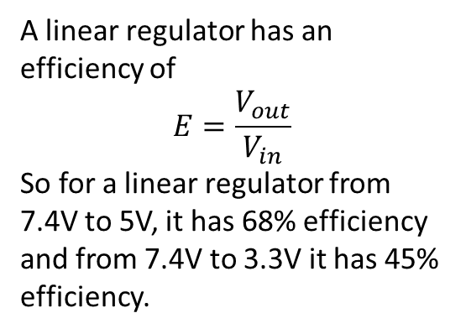
Efficiency
A linear regulator has an efficiency of
$$E=\frac{V_{out}}{V_{in}}$$
So for a linear regulator from 7.4V to 5V, it has 68% efficiency and from 7.4V to 3.3V it has 45% efficiency.

Slide 6
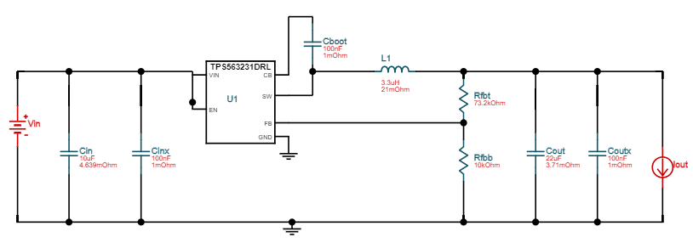
Schematic
Can change Rfbt to 45.3k to switch to 3.3v output
**I estimate that it will probably take up around 25% of board space compared to Amazon version
**Vin is between 4.5V and 17V

Slide 7
Cost
I found that cost was mostly driven by buck converter IC and the inductor
Component | Cost ($ at qty 10)
TPS562531 (Buck converter) | 0.726
3.3uH Inductor | 0.595
10uF Capacitor | 0.201
22uF Capacitor | 0.205
0.1uF Capacitor (x3) | 0.021
10k Resistor 1% | 0.015
73.2k Resistor 1% (5V version) | 0.015
45.3k Resistor 1% (3.3V version) | 0.015
Total Cost/Unit (qty 10) | 1.835
Total Cost/Unit (qty 100) | 1.218

